Slide 1
Crystallographic Planes
z
example
a b c
1. Intercepts
1/2 ∞ ∞
c
2. Reciprocals
1/½ 1/∞ 1/∞
2 0 0
3. Reduction
2 0 0
y
4. Miller Indices (200)
a
b
x

Slide 2
Crystallographic Planes
z
example
a b c
c
1. Intercepts
1/2 1 3/4
2. Reciprocals
1/½ 1/1 1/¾
2 1 4/3
y
3. Reduction
6 3 4
a
b
x
4. Miller Indices (634)

Slide 3
Miller Indices - Planes
intercept
reciprocal
x
1/4
4
y
∝
0
z
-1/2
-2

Slide 4
Miller Indices - Planes
intercept
reciprocal
x
1/4
4
y
-1/3
-3
z
-1/2
-2

Slide 5
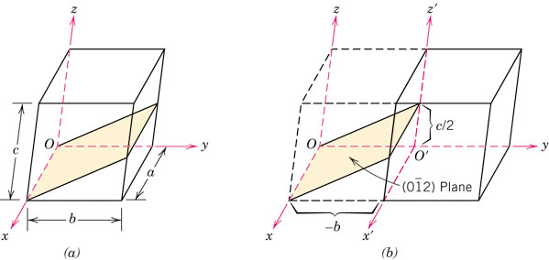
p_pg56
What is this plane?
Notes:
p_pg56.jpg

Slide 6
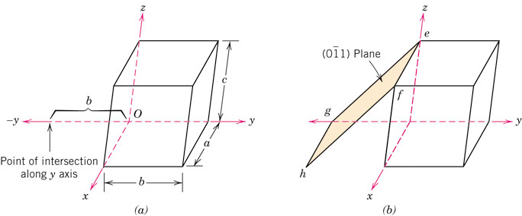
p_pg58
Which one is the plane?
Follow the steps in reverse order: 1) Take reciprocal 2) Determine the intercepts.
Notes:
p_pg58.jpg

Slide 7
Miller Indices
- No commas
- No fractions
- Negative indicated by bar over number
(hkl)
specific
Planes
{hkl}
family
[hkl]
specific
Directions
<hkl>
family
Family of Planes {hkl}
Ex: {100} = (100),
(010),
(001),
(100),
(010),
(001)

Slide 8
Equivalent Planes
A family of planes includes all planes which are equivalent by symmetry (Same atomic packing) - depends on crystal system.
- For cubic: (110),(011) and (101) are all {110}
- For tetragonal: (011) and (101) are {101}
but (110) is not (c≠a)
In the cubic system only, planes having the same indices, irrespective of order and sign, are equivalent
Both and belong to the {123} family

Slide 9
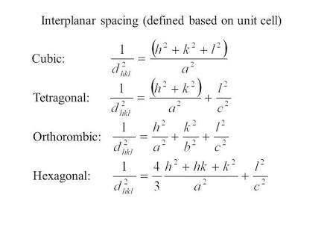
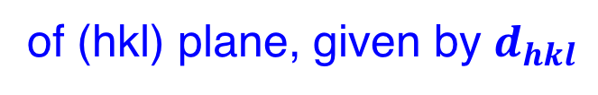
Inter planar spacing
of (hkl) plane, given by $d_{hkl}$

Slide 10
Angle between two crystallographic directions
The angle ‘θ’ between any two crystallographic directions
[u₁ v₁ w₁] and [u₂ v₂ w₂] can be calculated easily. The
angle ‘θ’ is given by,
The direction [h k l] is perpendicular to the plane (h k l)

Slide 11
Cubic crystals
One interesting and unique characteristic of cubic crystals is that planes and directions having the same indices are perpendicular to one another
For other crystal systems there are no simple geometrical relationships between planes and directions having the same indices

Slide 12
For cubic crystals

Slide 13
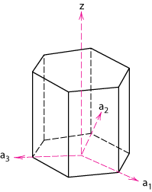
Crystallographic Planes (Hexagonal)
In hexagonal unit cells the same idea is used
z
example
a₁ a₂ a₃ c
1. Intercepts
1 ∞
-1
1
2. Reciprocals
1 1/∞
-1
1
1 0
-1
1
a₂
3. Reduction
1 0
-1
1
a₃
4. Miller Indices
a₁
(101)

Slide 14
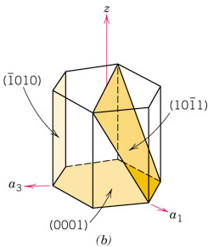
f08_03_pg54
4-index notation for Hexagonal crystals
Miller-Bravais indices
The third index is included to emphasize the symmetry; if the third index were not included, you might not realize that, e.g., the (110) and are crystallographically equivalent.
(hkl) → (hkil)
i = -(h+k)
Notes:
f08_03_pg54.jpg

Slide 15
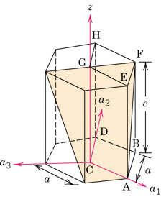
p_pg59
What is the Miller-Bravais indices of the plane?
(1 -1 0 1)
Notes:
p_pg59.jpg

